Slide 1


Example assignment brief
for assessment unit B1 in:
BTEC Level 3 Extended Diploma in Art and Design Practice
BTEC Level 3 Extended Diploma in Creative Media Practice
Progression

Slide 2
Progression
Guidance for teachers on using example assignment briefs
(delete slide prior to handing out to learners)
Example Assignment Briefs (EABs) are provided for use and guidance. They have been developed to provide realistic vocational scenarios as client briefs. The content demonstrates how briefs can be used for assignments for all or part of assessment units.
EABs can be adapted in any way to meet the needs of your learners and programme, however they must maintain the required features of an assignment for a BTEC qualification. Please see the Delivery Guide for this qualification for more information on setting and adapting assignments.
This assignment has been designed to support delivery of unit B1: Personal progression.
You should ensure the following sections of this assignment brief are appropriate for your programme and learners, and adapt as necessary e.g.:
Requirements: to indicate the types of media and outcomes.
Requirements – detail: to indicate the specific requirements for focused programmes, i.e. if the programme is fashion or games orientated, it would be advisable to set narrower outcome requirements.
Inspiration: to use examples of sources relevant to the programme.
Guidance: to indicate the specific expectations of how learners will develop and submit work. Additional deadlines can be included for different tasks within the assignment if needed.

Slide 3

Progression
Context
In an increasingly digitally focused industry, a personal brand identity, both online and in physical promotional materials, is essential in being a successful creative professional. You are planning to take your next step into higher education or further work experience, and are required to put together materials to promote yourself to employers, clients and/or universities.
Requirements
Self - promotional progression materials including online personal brand identity
Audience
The primary target audience is for future employers, work experience placements, clients or higher education providers.
Deadline
To be completed by assessor.
Resubmission deadline
To be completed by assessor.
Assessor
To be completed by assessor.
Brief

Slide 4
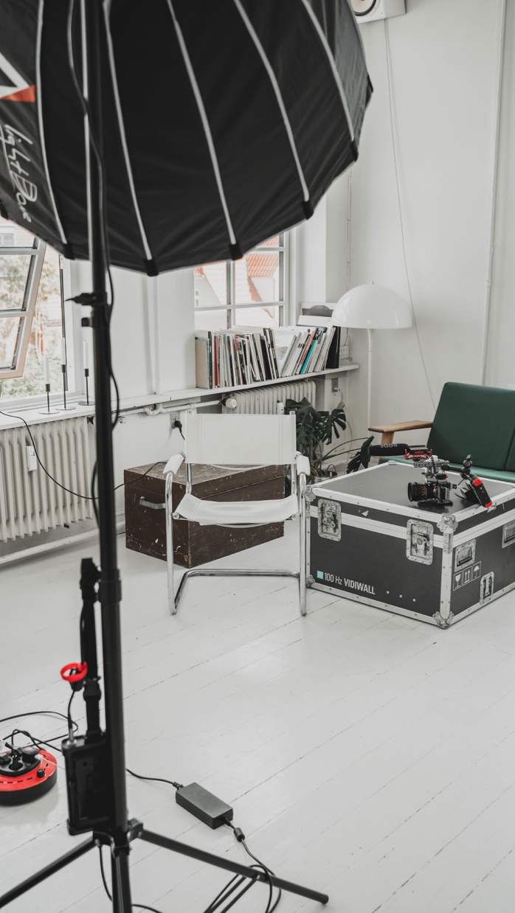
Progression
Requirements – detail:
Your online personal brand identity should provide a good insight into who you are as a creative practitioner. This should include examples of your creative work and information about you and your practice including:
Sources of inspiration
Concepts of contexts explored
Competitions of commissions you have undertaken
Practitioner statement
Biography/CV/Resumè
Evidence of networking
As well as developing your online personal brand identity you will also develop your skills for progression by taking part in a mock interview.

Slide 5

Guidance overview
You will need to plan and organise your project individually as part of your professional practice and problem solving.
The assessment criteria are not a series of tasks that are completed independently. You will use a combination of skills relating to the criteria continuously throughout the assignment.
They criteria are equally weighted, meaning they should be given equal importance in your project.
The guidance slides of this assignment brief indicate how you could approach each of those skills and what types of evidence you could produce.
Progression
AC1: Informing ideas
Use skills for informing ideas, interpreting the brief and developing ideas and outcomes as they progress.
AC5: Communication
Show skills in communicating the meaning, purpose and function of work, including development, outcomes and presentation, in order to engage the audience.
Communication
Informing ideas
AC2: Problem solving
Show problem solving throughout by engaging with the brief and its requirements including ideas generation, experimentation, testing and reflection on the meaning, purpose function of your work.
AC4: Professional practice
Show how you apply professionalism to your assignment through technical practice, project management and working safely.
Professional practice
Problem solving
Technical skills
AC3: Technical skill
Show technical skills throughout by exploiting the potential of media, materials, techniques and processes. In early stages of the project, this might be when investigating material opportunities. Later it would be in the outcomes or their presentation.

Slide 6

Guidance
Progression
Informing ideas
You should inform you ideas at all stages of the assignment.
Considering your own progression options offer a wide range of potential starting points such as:
Progression opportunities including:
  higher education
  employment
  further training
  self employment
Job roles or longer term progression opportunities within your chosen industry
Useful things you think everyone should know about you
Primary and secondary methods for informing ideas:
Interpret the brief – requirements, purpose
    Review other practitioners’ online brands and presence
    Explore progression opportunities
    Explore the creative industry
    Explore self employment and funding opportunities
    Use of research to inform development, outcomes and presentation to improve and refine work and ideas
Evidence could include:
Initial presentation of findings - informed by research, explaining how it will meet the brief
Performance during mock interview
Blog or digital portfolio of iterative use of research to inform ideas for development, outcomes and presentation

Slide 7

Guidance
Progression
Problem solving
You should use problem solving at all stages of the assignment by testing, review and reflecting on progress of:
Interpreting the brief, requirements, purpose
Identifying career aspirations and skills required.
Establishing short-, medium- and long-term progression aims.
Generating an online personal brand identity
Applying stages of the creative process in order to develop and refine
Obtaining and acting on constructive feedback.
Evidence could include:
Blog, digital portfolio and/or sketchbook documenting:
Online personal brand identity
Ongoing testing review and reflection
Iterative development and refinement or work and ideas

Slide 8

Guidance
Progression
Technical skills
You should use the most appropriate and effective technical skills throughout your project:
Development of work:
  capturing/recording, editing and organising material
  trying different techniques and seeing what is the most useful
  exploring the properties of different media and different platforms and making comparisons
  taking work through a series of different processes to compare outcomes.
Production of online personal brand identity
Evidence could include:
Blog, digital portfolio and/or sketchbook with:
Initial intentions presentation – with early draft work and practical research into media and techniques
Outcome presentation

Slide 9

Guidance
Progression
Professional practice
You should apply professional practice when working on the assignment by:
Identifying and using best practice associated with online personal brand identity
  consider and test what others do in industry
  keep things safe and manage risks.
Applying project management:
  setting priorities
  breaking up the assignment into manageable parts
  exploring ways of working efficiently.
Setting actions and targets for meeting the brief:
  organising materials and resources
  responding in a timely fashion and meeting set deadlines..
Addressing interviewers appropriatel:
      timeliness
      positive body language
      use of technical language
      appropriate dress code
Evidence could include:
Blog, digital portfolio and/or sketchbook with:
Presentation of online personal brand identity
Recording of mock interview
Outcome(s) that show an understanding of related professional practices

Slide 10

Guidance
Progression
Communication
You should use communication skills throughout the project by:
Considering audience and purpose
Working to ensure the meaning, message and impact are clear
Using visual language and creative forms of communication
Communication opportunities:
Presenting work and professional profiles through relevant formats,
Using multiple channels
Developing and maintaining networks
Personal communication and interview skills:
Evidence could include:
Blog or digital portfolio with:
Initial intentions presentation – personal communication
Recording of mock interview
Presentation of online personal brand identity

Slide 11
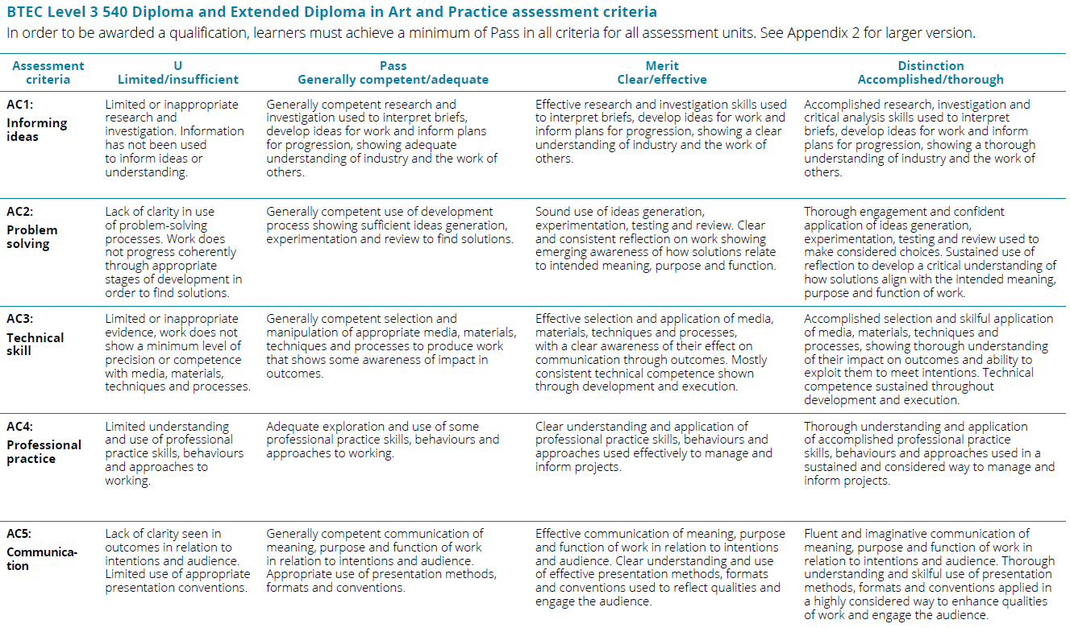
Progression

